Slide 1
1st Year
Christmas Exams 2025
Helpful tips and reminders
for you first exams

Slide 2
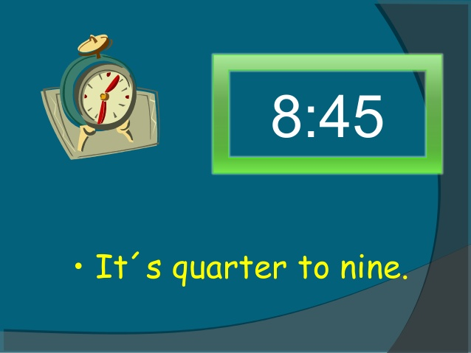
Be at the Sports Hall before 8. 45am
for Tutor Roll Call

Slide 3
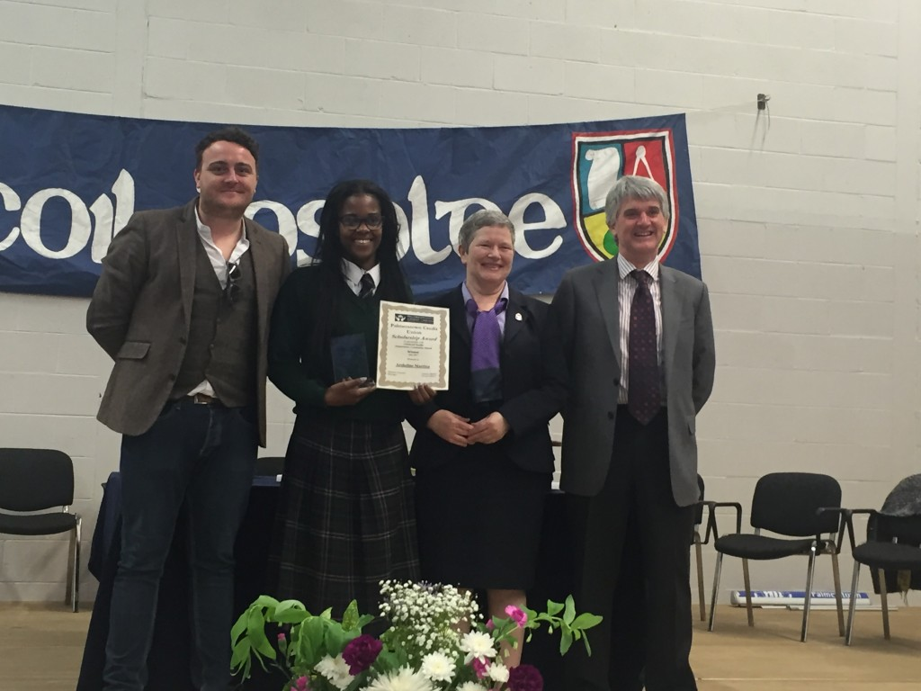
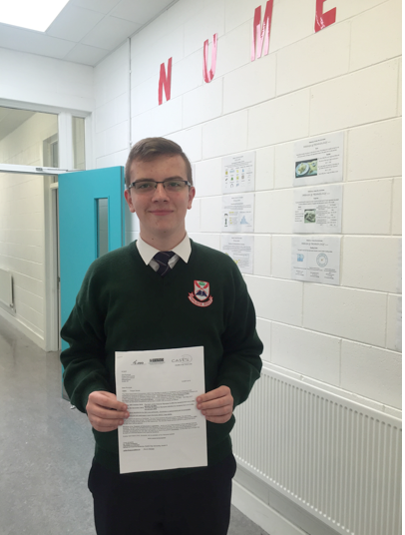
Correct Uniform on

Slide 4
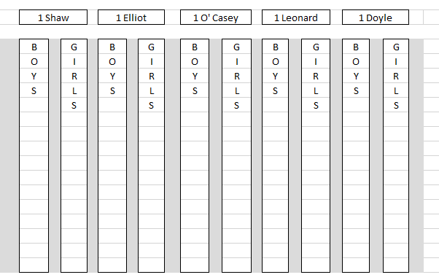
Seating Plan for Sports Hall

Slide 5
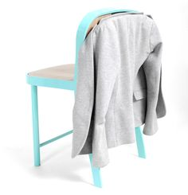
Coat on back of your chair

Slide 6
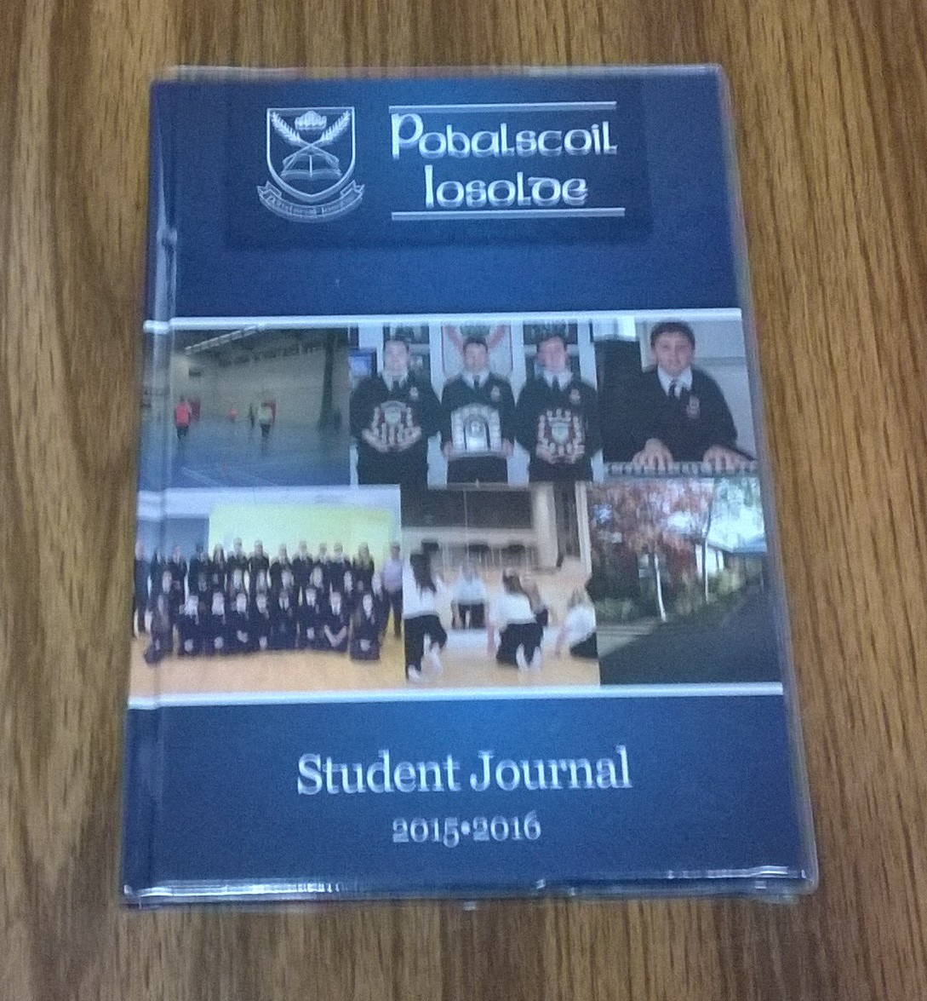
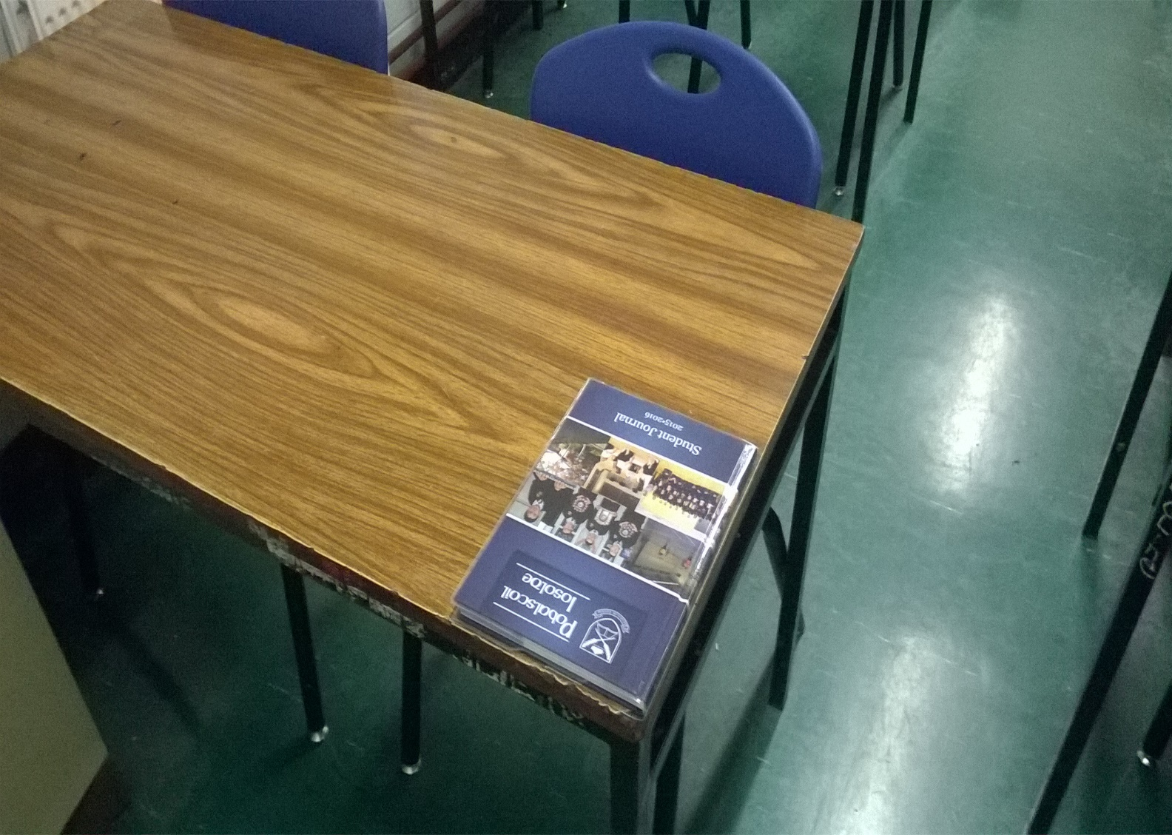
Take out your Journal first thing in the morning

Slide 7
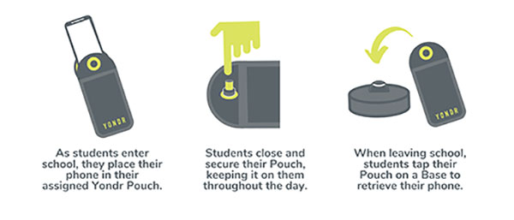
Phone inside the Yondr pouch, leave it on the desk with your Journal

Slide 8
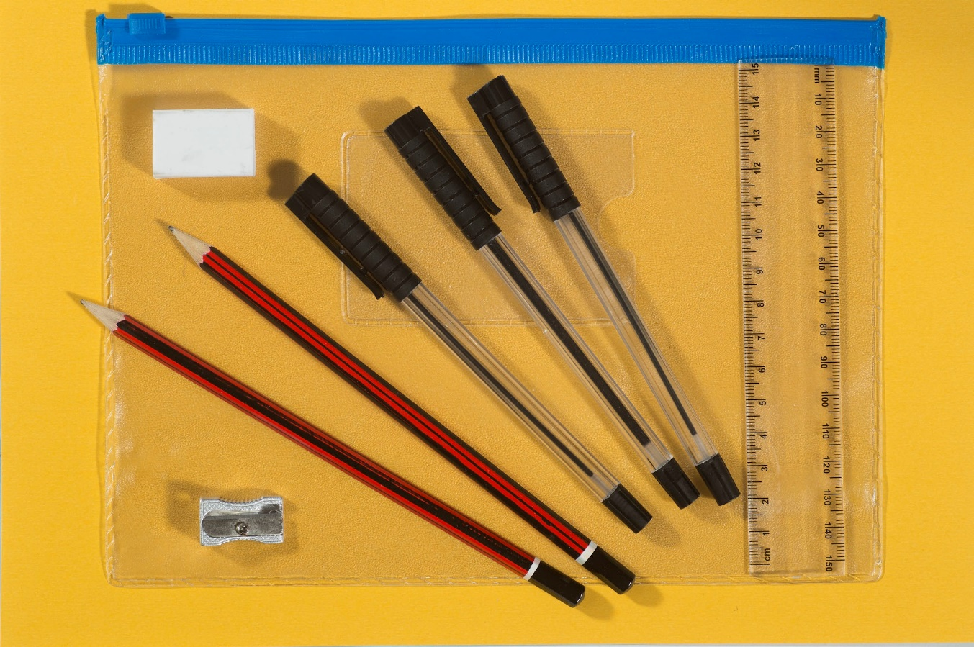
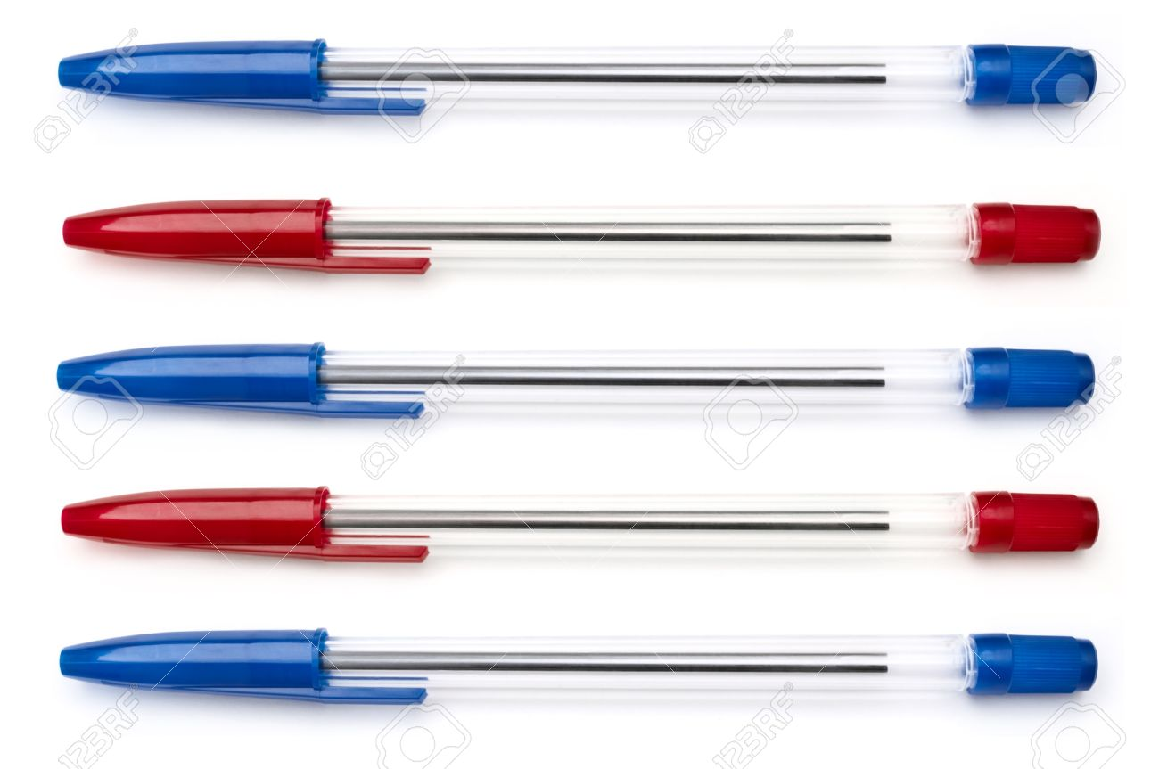
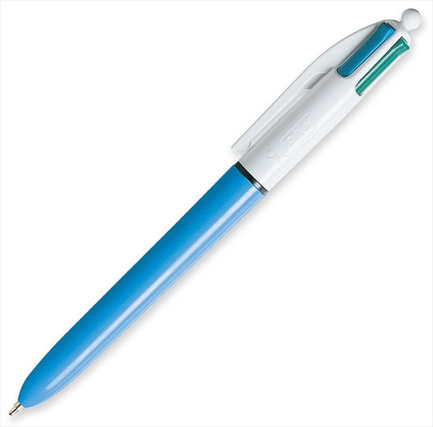
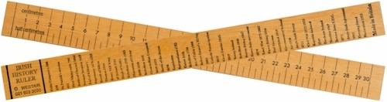
Equipment in your pencil case

Slide 9
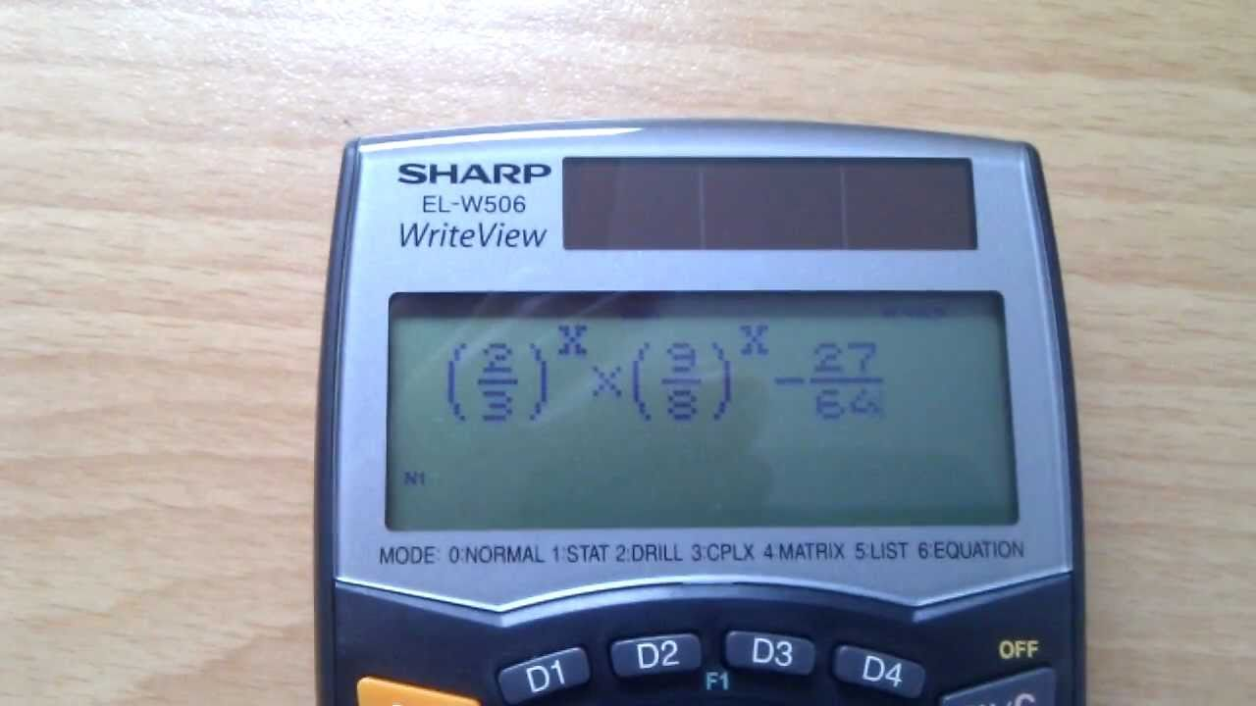
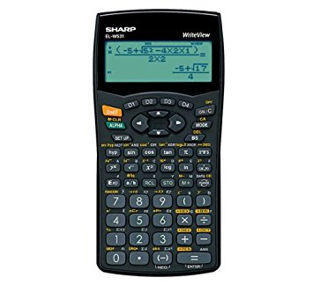
Sharp WriteView Calculator

Slide 10
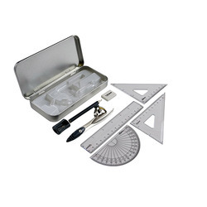
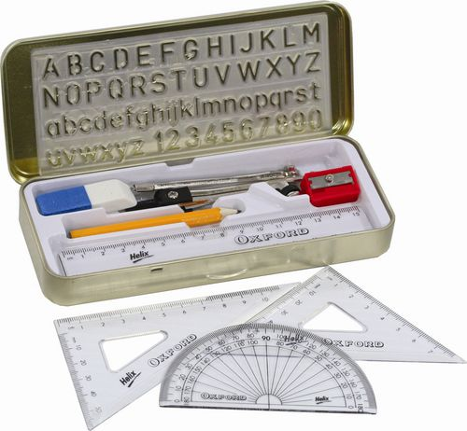
Geometry Set

Slide 11

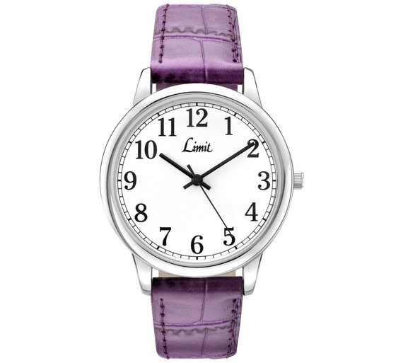

Slide 12
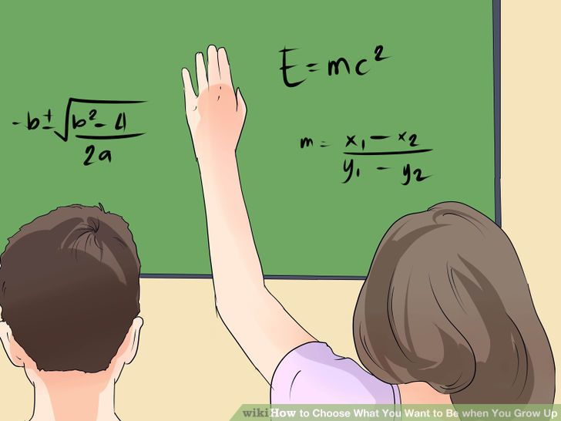

Hand up if you wish to ask a teacher for more paper or explaining a word

Slide 13
Fill in all questions
Look for attempt marks even if you don’t know the full answer
Leaving a blank is Zero marks

Slide 14
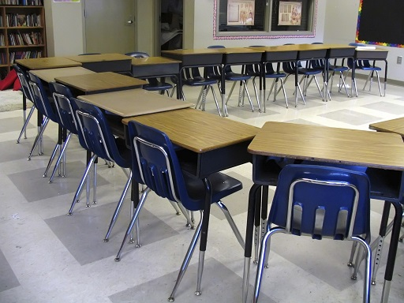
Chairs under the desk when leaving the Hall

Slide 15
If you do not do Irish or a Language subject
You can study at home and come in when your own exams are on

